Slide 1



DIRECT-TO-EMPLOYER PLAN MODELING FOR TAMPA GENERAL HOSPITAL
SEPTEMBER 9, 2024

Slide 2


Market Leader in Private Labeled DTE Plans
Louisville, KY
OneHealth Plan
Cincinnati, OH
TCH Optimal
Bentonville, AR
Northwest Health Plan
Knoxville, TN
East Tennessee Health Plan
Meridian, MS
Affinity Health Plan
Fort Myers, FL
Lee Health Care Partners

Slide 3

Direct-to-Employer (DTE) Your Health Plan Focused on a Direct Relationship with Self-Funded Employers in Your Market
YOU Pick the Name of the Health Plan
YOU Determine the Fees Charged
YOU Practice the Medicine
YOU Receive the Profits
WE Make it Successful

Slide 4

DTE Keys to Success for Tampa General Hospital
1
2
DTE Plan Sells
DTE plans only work when the network is built around a strong brand with good access and competitive costs.
Tampa General Hospital is the quality leader in the Tampa area but with only one location will struggle some with access. Because TGH is the quality leader, KBA expects this plan will sell well.
Estimates for Margin and Steerage Hold
KBA models high, medium and low estimates for net income based on the within-DTE-network steerage rate.
Profit growth will hold if this assumption accurately play out as expected for Tampa General Hospital.

Slide 5
Every $1 of Care
Government Pay
Commercial Pay
Results in
~$1.06 of loss
Generates
~$0.22 of profit
See slide 24 for more details on the calculation of commercial and government-pay net income.

Slide 6

Direct-to-Employer Strategy: Powerful Employer Value
Reduced medical spend through lower unit costs and better integrated care
“At the table” with Tampa General Hospital
Aligned financial incentives
Complete transparency for unlimited visibility into health benefit plan expenses and cost drivers
Aggressive stop-loss premiums and policy terms
Increased employee satisfaction
Improved cash flow & stabilization of future medical cost trend

Slide 7
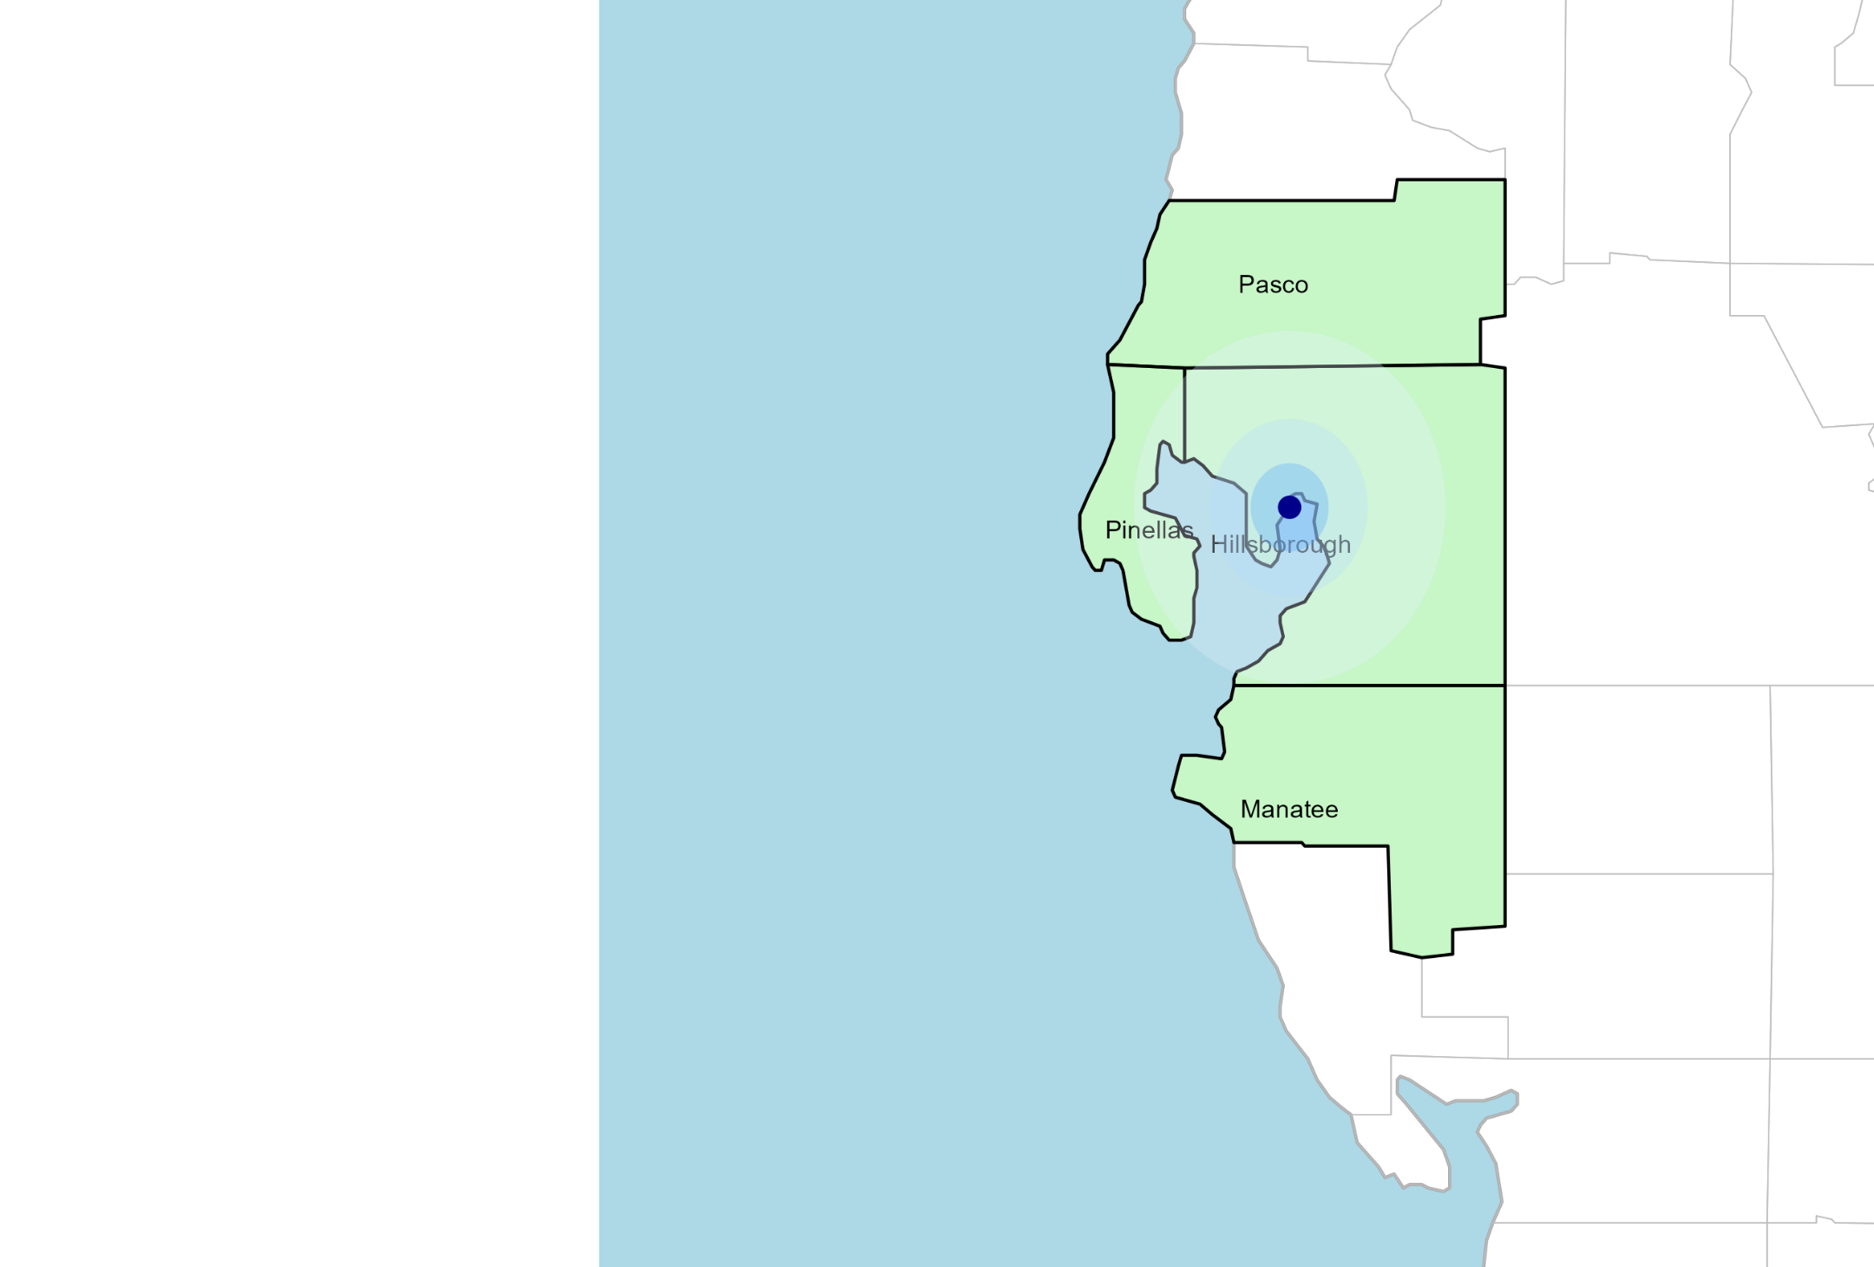
Significant Opportunity for Plan Growth Researched for Hillsborough, Manatee, Pasco, and Pinellas Counties*
Target Market 4,500+ Employers 800,000+ Employees 1,200,000+ Members
 | Employer Size Group (# of Employees)
Commercial Employers Headquartered in: | 50-100 | 101-200 | 201-400 | 401-1,000 | 1,001-3,000 | 3,000+
Hillsborough, Manatee, Pasco and Pinellas Counties | 2,548 | 981 | 627 | 341 | 104 | 74
Estimated Employees in Above Employers (Some living outside of region) | 50-100 | 101-200 | 201-400 | 401-1,000 | 1,001-3,000 | 3,000+
Hillsborough, Manatee, Pasco and Pinellas Counties | 191,000 | 147,000 | 180,000 | 238,000 | 208,000 | 665,000
Estimated Employees in Above Employers (Some living outside of region) | 50-100 | 101-200 | 201-400 | 401-1,000 | 1,001-3,000 | 3,000+
Hillsborough, Manatee, Pasco and Pinellas Counties | 290,000 | 245,000 | 295,000 | 420,000 | 405,000 | 930,000

Slide 8
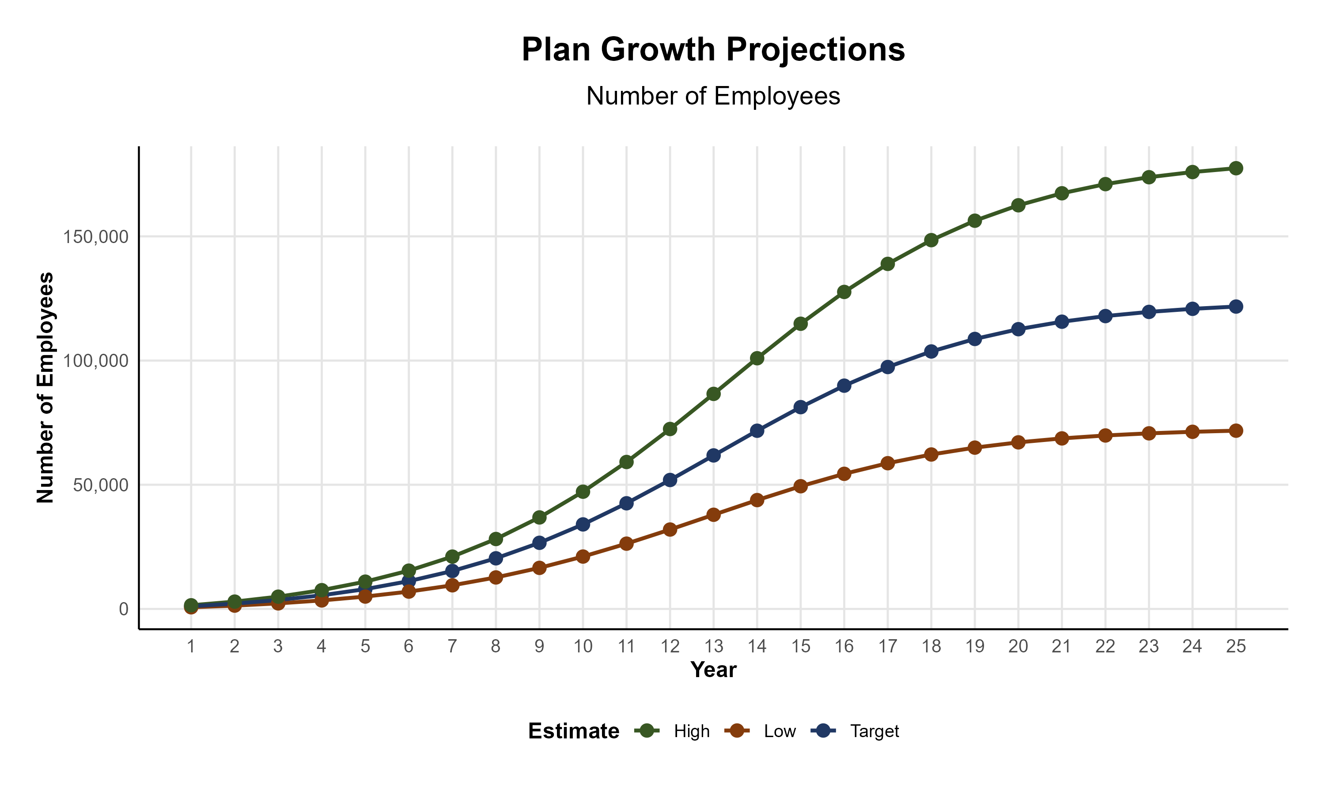
Plan Potential Growth Paths
Self Funded
807K
PLAN GROWTH POTENTIAL
1,332K
Insured
Working Age
1,984K
Population
3,403K
Estimates include Hillsborough, Manatee, Pasco, and Pinellas Counties

Slide 9

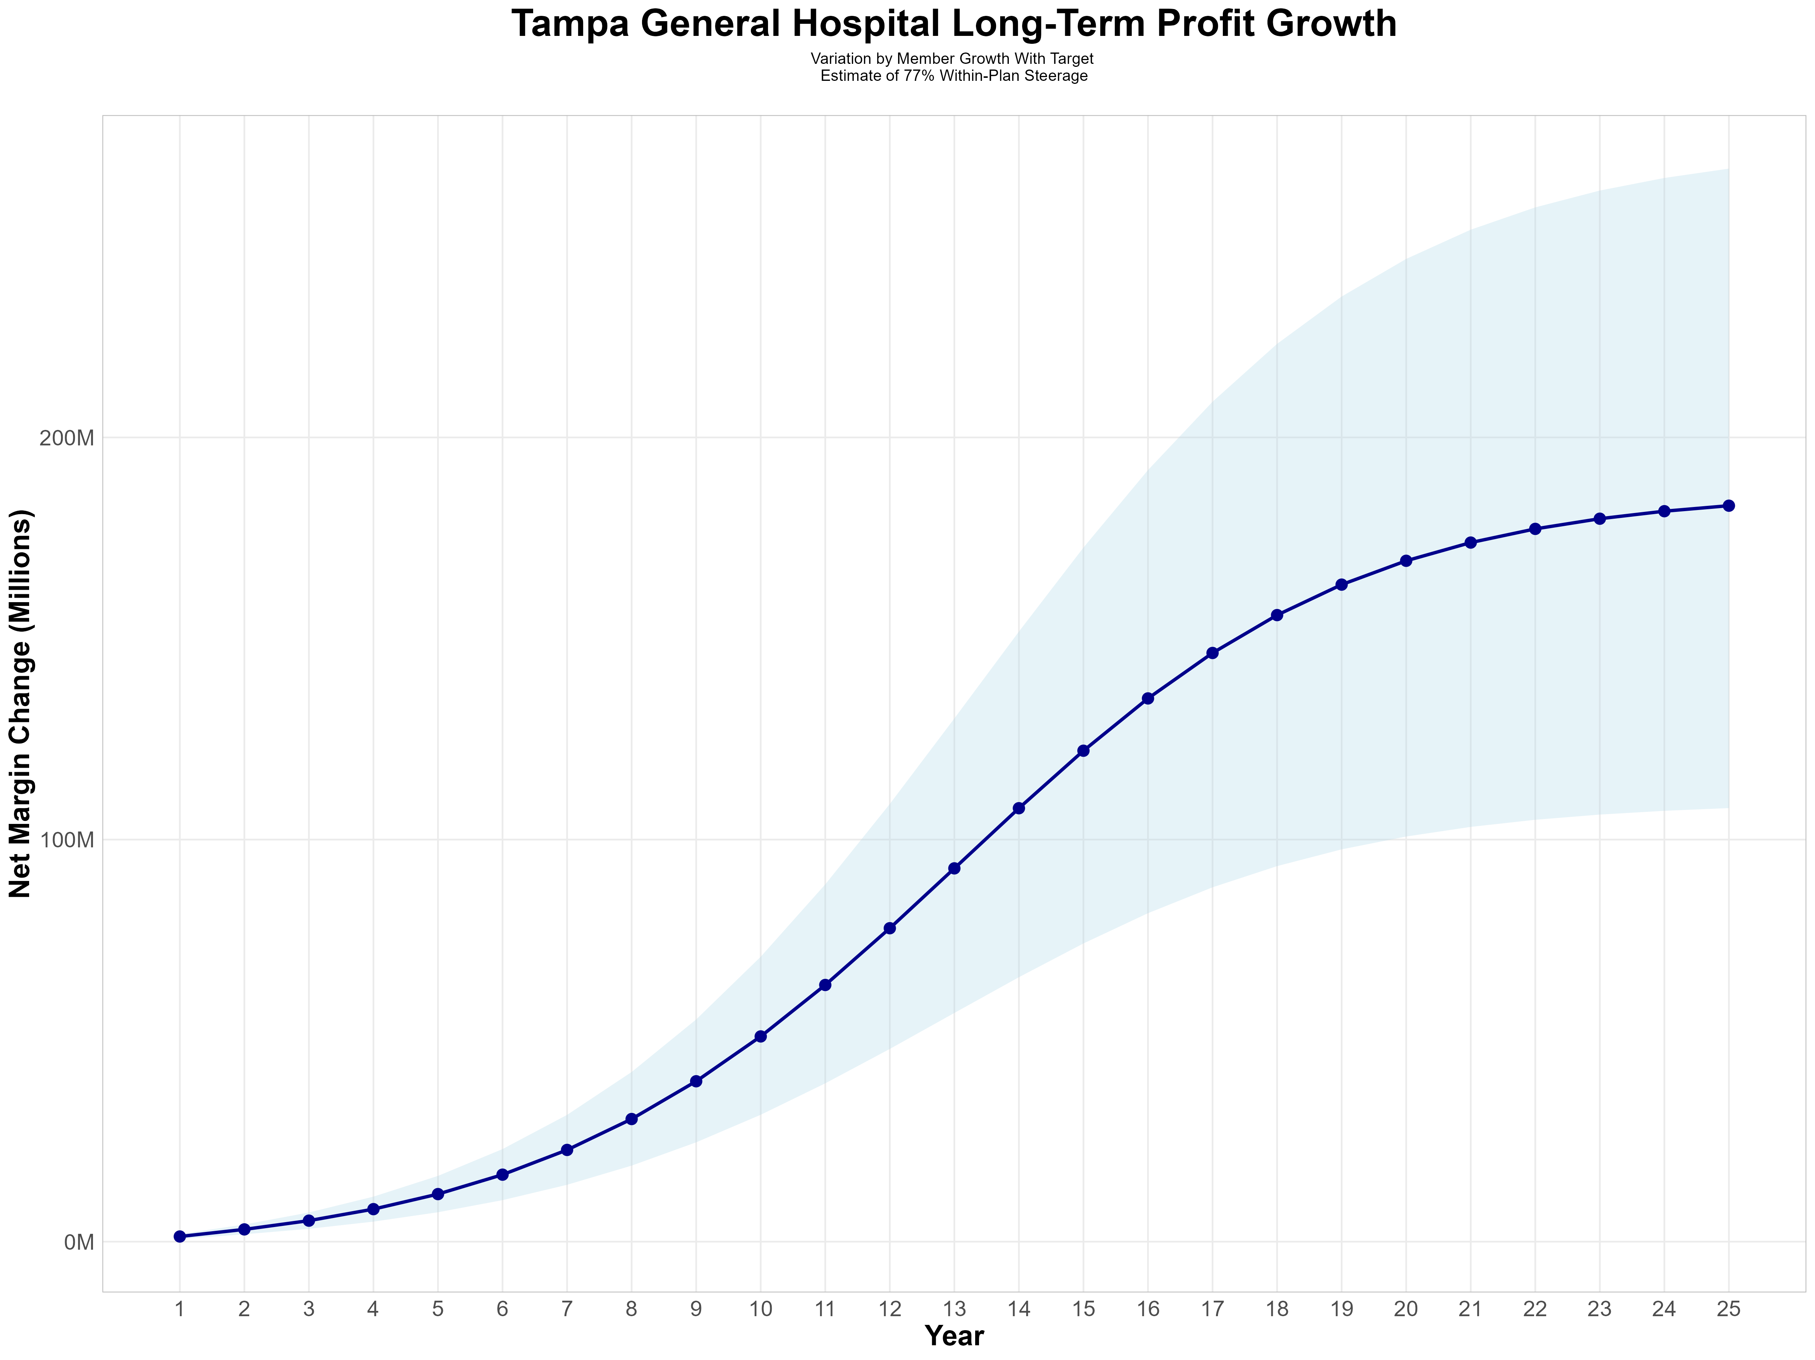
Growing Powerful, Lasting Profitability
Early Stage
Graining Name Recognition, Early Growth
New Revenue:
New Profit:
$75.23M
$12.43M
Growth Stage
Strong Reputation, Strong Growth
New Revenue:
New Profit:
$515.13M
$86.32M
Mature Stage
High Profitability, Market Saturation
New Revenue:
New Profit:
$1013.84M
$170.06M

Slide 10
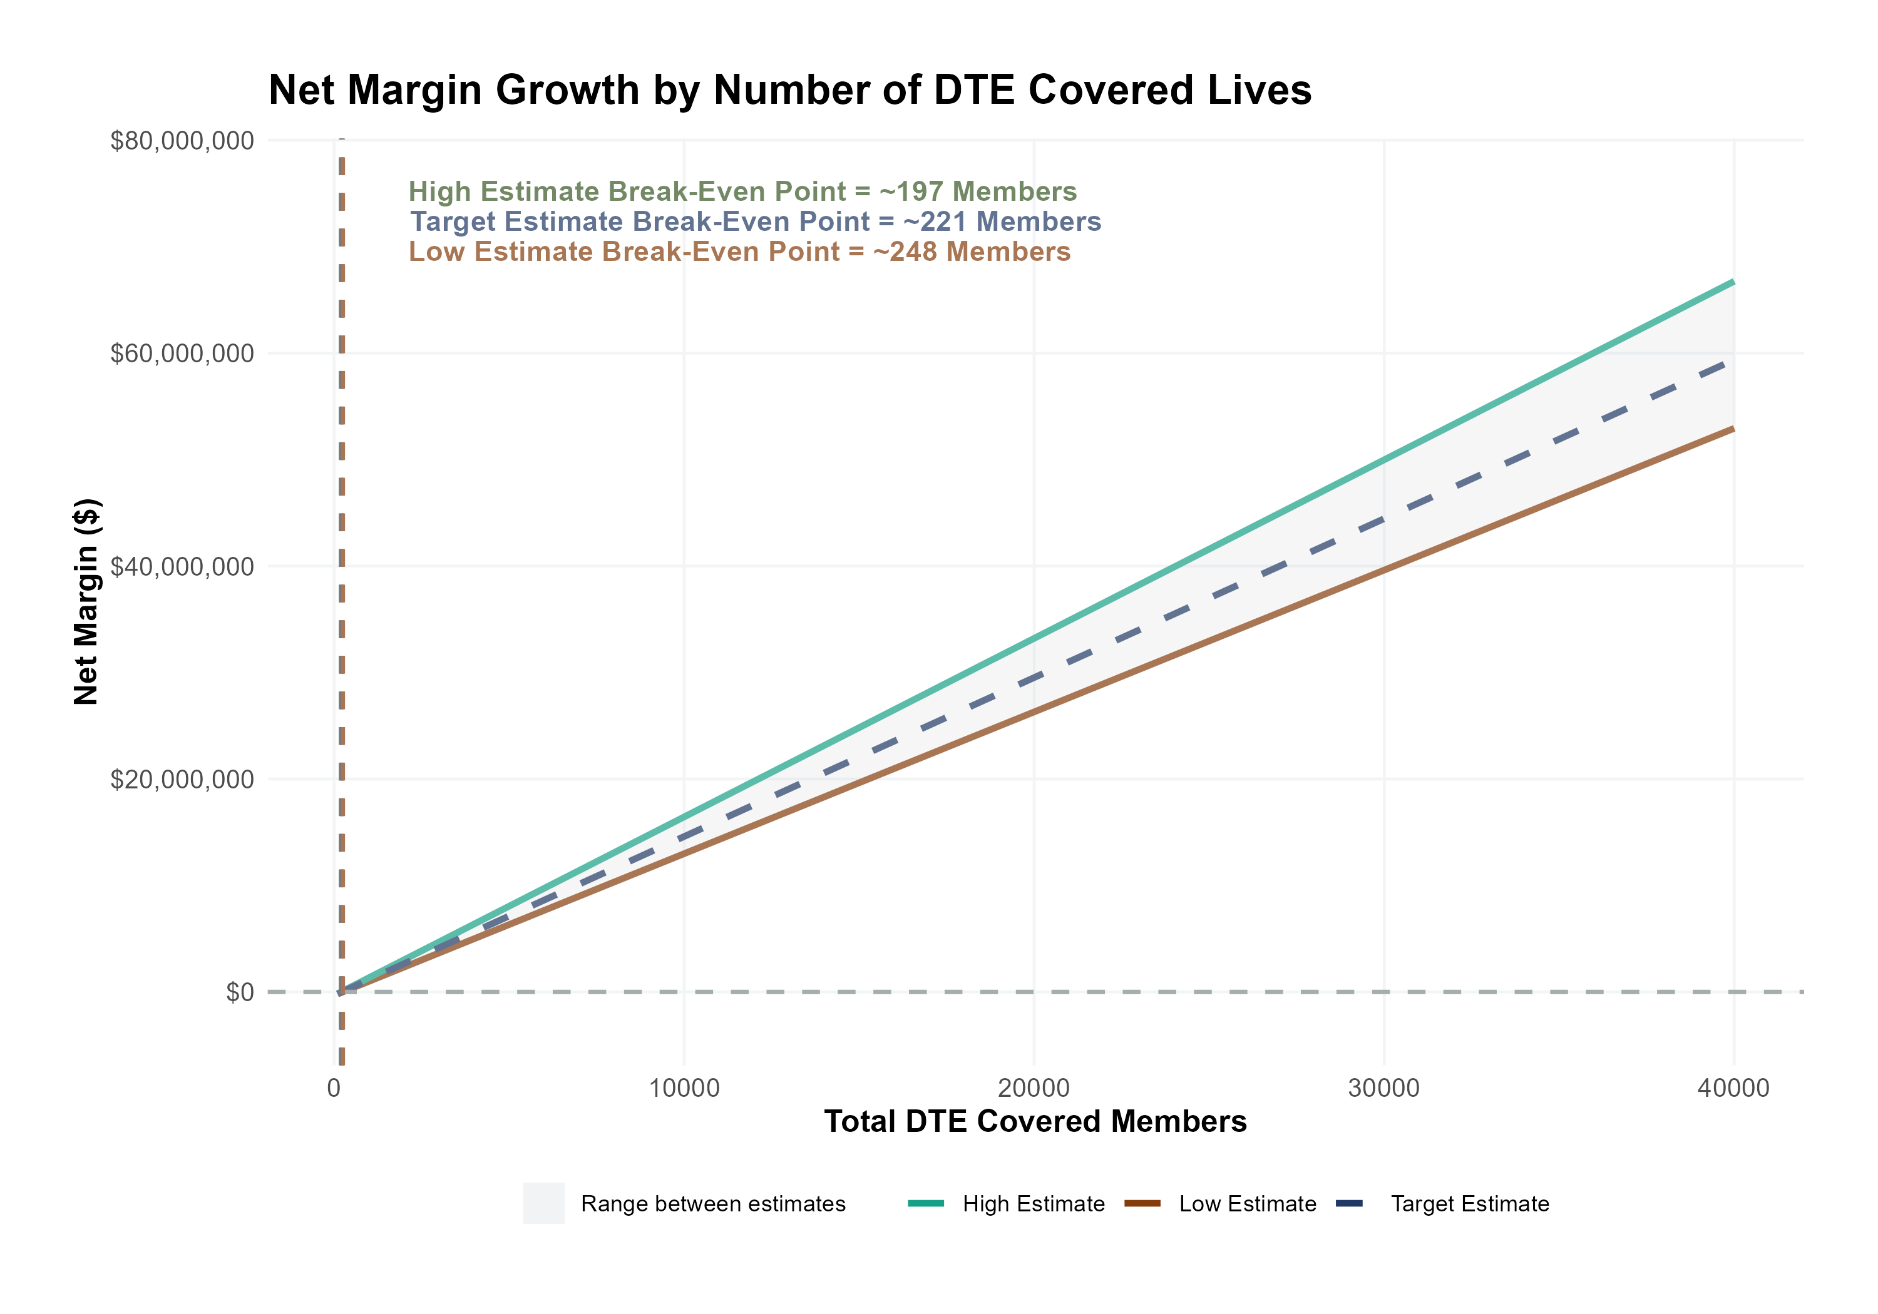
Estimated Financial Returns and Assumptions
Patient Steerage Assumptions
SINGLE-YEAR PROJECTION
KBA currently estimates that Tampa General Hospital has 21% inpatient market share, and 6% outpatient market compared to hospitals/clinics in the Hillsborough, Manatee, Pasco, and Pinellas Counties. Based on other KBA DTE networks, we expect steerage to be:
Low
Target
High
70%
77%
85%

Slide 11
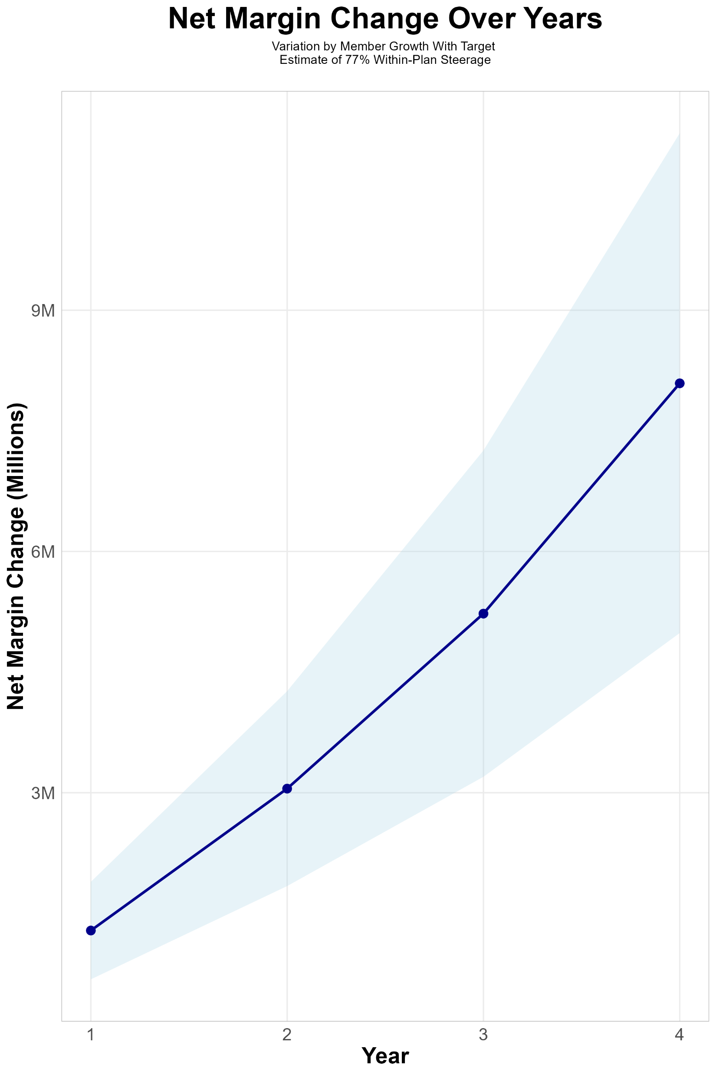
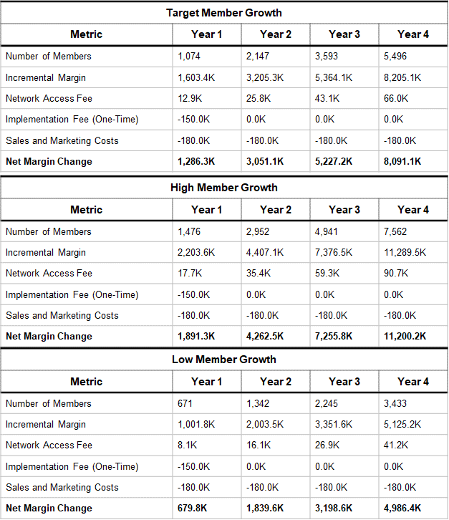
FOUR-YEAR PROJECTIONS

Slide 12
Direct-to-Employer Strategy: Only Available to Premier Health Systems
STRONG Brand Quality
EXTENSIVE Patient Access
AFFORDABLE Value Pricing
EXCELLENT Care Quality

Slide 13
TGH NETWORK
Out of Network
Friends & Family (Contracted)
Wrap Network (Rented)
TGH’s Network
The medical providers in your direct control or part of Tampa General Hospital’s integrated delivery system
Potential risk sharing arrangements (e.g. employer stop-loss participation)
Friends & Family Providers – TIER 1
Access through direct contracts at the discretion of Tampa General Hospital
WRAP NETWORK
Medical services from national PPO networks for members that travel, tertiary and specialty services you do not provide, and employees residing outside your direct catchment area
OUT-OF-NETWORK
Non-contracted medical providers

Slide 14

BENEFIT PLAN DESIGNS THAT OPTIMIZE STEERAGE TO TGH
Exclusive Provider Organization (EPO) Plan Design Structure

Slide 15
SINGLE YEAR SUMMARY
DTE Covered Members Financial Analysis | DTE Covered Members Financial Analysis | DTE Covered Members Financial Analysis | DTE Covered Members Financial Analysis | DTE Covered Members Financial Analysis | DTE Covered Members Financial Analysis | DTE Covered Members Financial Analysis | DTE Covered Members Financial Analysis
Target Estimate of 77% Within-Plan Steerage. | Target Estimate of 77% Within-Plan Steerage. | Target Estimate of 77% Within-Plan Steerage. | Target Estimate of 77% Within-Plan Steerage. | Target Estimate of 77% Within-Plan Steerage. | Target Estimate of 77% Within-Plan Steerage. | Target Estimate of 77% Within-Plan Steerage. | Target Estimate of 77% Within-Plan Steerage.
DTE Members | Pre-DTE Revenue | Pre-DTE Margin | DTE Revenue | DTE Incr. Revenue | DTE Total Margin | DTE Incr. Margin | Net Margin Less DTE Fees
100 | $ 131K | $ 29K | $ 1,027K | $ 896K | $ 177K | $ 148K | $ -181K
500 | $ 656K | $ 146K | $ 5,137K | $ 4,481K | $ 887K | $ 740K | $ 416K
1,000 | $ 1,312K | $ 292K | $ 10,275K | $ 8,962K | $ 1,773K | $ 1,481K | $ 1,163K
2,500 | $ 3,281K | $ 730K | $ 25,687K | $ 22,406K | $ 4,433K | $ 3,702K | $ 3,402K
10,000 | $13,125K | $2,921K | $102,749K | $ 89,624K | $17,730K | $14,809K | $14,599K
20,000 | $26,249K | $5,842K | $205,498K | $179,249K | $35,460K | $29,618K | $29,528K
NOTE: Please see detailed financial analysis and assumptions used starting on page 23.
Financial projections do not include 340B contribution margin, which could represent $136 PMPM by optimizing 340B through Rx plan design, TGH’s approved site(s) with network integration, and development of TGH’s proprietary PBM program.

Slide 16

the missing piece to population health success
Patient engagement is the failure point of population health efforts. Direct employer participation and TGH’s clinical leadership is key to driving patient engagement.
KBA’s DTE strategy positions Tampa General Hospital to grow commercial market share by reducing per-employee plan costs even further at a time when employers are desperate for a path to better value.
Tampa General Hospital can demonstrate greater completion rates for Standards of Care for the Chronically Ill, driving better care & cost outcomes.
Adding TGH’s managed care processes to KBA’s patented care management programs will turbocharge results – Positioning TGH as a transformational population health leader.
Tampa General Hospital CAN PROMOTE THESE RESULTS FROM DAY ONE!!

Slide 17

CHRONIC CONDITION | MINIMUM ANNUAL CARE RECOMMENDED
ASTHMA | 2 Clinical Evaluations 1 Spirometry (for patients 10 years of age or older)
ATRIAL FIBRILLATION | 1 Clinical Evaluation
CHRONIC OBSTRUCTIVE PULMONARY DISEASE | 1 Clinical Evaluation 1 Spirometry
CHRONIC VENOUS THROMBOTIC DISEASE previously listed as Thrombo-embolic Disease | 1 Clinical Evaluation
COPD WITH PULMONARY HYPERTENSION/COR PULMONALE | 2 Clinical Evaluations 12 months of supplemental 02 Tx
CHRONIC KIDNEY DISEASE | 1 Clinical Evaluation 1 Hgb or Hcrt | 1 Serum Creatinine 1 Serum Potassium | 1 Serum Calcium 1 Serum Phosphorus
CONGESTIVE HEART FAILURE | 1 Clinical Evaluation | 1 Serum Creatinine | 1 Serum Potassium
CORONARY ARTERY DISEASE | 1 Clinical Evaluation | 1 LDL
DEPRESSION | 1 Clinical Evaluation
DIABETES | 2 Clinical Evaluations 2 Glycohemoglobins 1 Serum Creatinine | 1 Lipid Panel IF no nephropathy Dx or ACE/ARB Rx, 1 Urine Albumin/Creatinine ratio, Total Protein
EPILEPSY | 1 Clinical Evaluation
HUMAN IMMUNODEFICIENCY VIRUS INFECTION | 2 Clinical Evaluations 2CBCs I T-Cell/CD-4 Count | 2 HIV Quantifications 1 Pap Smear (for women only, 21 years of age or older)
Hyperlipidemia | 1 Lipid Panel
HYPERTENSION | 1 Clinical Evaluation | 1 Serum Creatinine
HYPERTHYROIDISM | 1 Clinical Evaluation | 1 TSH | 1 T4
HYPOTHYROIDISM | 1 Clinical Evaluation | 1 TSH
METABOLIC SYNDROME | 1 Clinical Evaluation | 1 Lipid Panel | 1 FBS or HgbA1c
MULTIPLE SCLEROSIS | 1 Clinical Evaluation
PARKINSON'S DISEASE | 1 Clinical Evaluation
PERIPHERAL ARTERIAL DISEASE (ATHEROSCLEROSIS] previously listed as Peripheral Vascular Disease | 1 Clinical Evaluation 1 LDL
PRE-DIABETES | 1 Clinical Evaluation | 1 Lipid Panel | 1 FBS or HgbA1c
POLYMYALGIA RHEUMATICA | 2 Clinical Evaluation | 2 ESR or CRP | 1 CBC
PULMONARY HYPERTENSION (UNRELATED TO COPD) | 2 Clinical Evaluation
REGIONAL ENTERITIS (INFLAMMATORY BOWEL DISEASE) | 1 Clinical Evaluation
RHEUMATOID ARTHRITIS | 1 Clinical Evaluation
SLEEP APNEA | 1 Clinical Evaluation
ULCERATIVE COLITIS (INFLAMMATORY BOWEL DISEASE) | 1 Clinical Evaluation
INTEGRATION WITH EPIC EHR SYSTEM
CHRONIC DISEASE MANAGEMENT
The chronic diseases identified include a list of services (i.e. exams, lab work and diagnostics) rendered by a network provider payable at 100% and not subject to the deductible or copay.
KBA shares evidence-based standards of care for 27 chronic conditions directly into Epic.

Slide 18

Transparent PBM Integration
Support of TGH’s retail pharmacy(s)
Optimize TGH’s 340B drug pricing program
Allows TGH to create its own PBM program if desired
Custom telephone number with personalized scripting and separate call tracking & reporting
Fully customizable member welcome booklet & materials
White labeled formulary document and marketing materials
CUSTOM CLIENT SUPPORT:
Specialized call center capabilities
Fully customizable plan designs
Operational access to the platform
Customized process and functions to promote DTE strategy
CLINICAL FLEXIBILITY:
Full portfolio of custom formulary offerings – with optimized formulary shield
Clinical programs that drive towards overall DTE strategy
Options for additional drug savings by driving members to lower cost alternatives
Flexibility to customize or layer on utilization management programs

Slide 19
STOP-LOSS INSURANCE
Tokio Marine
Nationwide
Berkshire Hathaway
Sun Life
Liberty Mutual
Granular (Google)
Companion Life
Crum & Forster
American Fidelity
RGA
KBA has over 20 stop-loss underwriters and carriers that we work with on core employer sponsored plans and DTE health plans;
KBA performs a comprehensive analysis of each stop-loss partner to approve them for our business;
KBA provides comprehensive pricing and medical service analysis for each DTE health plan to ensure proper pricing;
KBA is also evaluated by the stop-loss markets to be an approved claims payer for them;
KBA provides the administration required of the stop-loss markets:
Bordereau Reporting;
Claim Reporting and Reconciliation;
Evaluation of Networks;
Care Management;
Initial Underwriting;
Negotiation of rates and terms; and
Plan Design Actuarial

Slide 20

DTE PROGRAM MARKETING & SALES
KBA WORKS WITH YOU TO MANAGE & SELL:
Branding & Messaging
Direct & Brokerage Sales Distribution – Focused Sales Representative
Brochures, Web Site, Media, etc.
Stop-Loss/Level Funded Down to 20 EE Lives
Sell Through Established Brokers in Your Service Area

Slide 21

Complete Sales Distribution System
BROKER DEVELOPMENT
Identification of Key Distribution Agents
Training and Development
DIRECT SALES
Identification of Key Targets
Working with TGH on Specific Employers
SALES ADMINISTRATION
Quote System
Quote Evaluation
Compensation
Meet and Greet
Sales Process
Closing
Stop Loss Negotiations
Reporting & Analysis
Proposal Development

Slide 22









Complete Marketing System
Customized Branding and Messaging
Customized Brochures
Customized Web Site
Targeted Employer Outreach
Sales System (Social Media, Email, Text, etc.)

Slide 23

FINANCIAL PROJECTIONS & ASSUMPTIONS:

Slide 24
Estimation of TGH’s 2021 Payer Mix
Payer Group | Total Inpatient Days | Revenue | Payer Mix
All TGH | 300,552 | $1,952,917K | 100%
Medicare | 63,163 | $286,696K | 21%
Medicaid | 26,536 | $203,388K | 9%
Other Government Pay | 0
No-Pay, Charity Care | 27,842 | ($199,377K) | 9%
Commercial/Self Pay | 183,011 | $1,461,799K | 61%
Estimating Payer Mix
Medicare, Medicaid, and other government payer mixes are estimated as the percentage of inpatient days for each group divided by total inpatient days.
No-pay and charity care is estimated as the percentage of no-pay/charity care compared to total overall revenue.
Commercial/self pay is assumed to be the rest of the total payer mix share.
Estimating Total Inpatient Days
Total inpatient days for ‘No Pay’ and ‘Commercial’ are estimated to be the payer mix estimates for “No Pay, Charity Care” and “Commercial/Self Pay” multiplied by the total number of inpatient days.
Values in blue are taken from the 2021 Medicare Provider Cost Report (https://data.cms.gov/provider-compliance/cost-report/hospital-provider-cost-report/data)
Values in yellow are taken from Definitive Healthcare data.
Total Medicare patient revenue is reported by CMS in the Medicare Provider Analysis and Review Report (MedPAR)
In other analysis, the outpatient payer mix is assumed to mirror the inpatient payer mix.

Slide 25
Estimation of Margin for Commercial vs. Government Pay
The RAND data for TGH estimates commercial insurance reimbursements at 265% of Medicare Rates
Estimating Commercial Margin
(Calculated through counterfactual of assuming all CMS/Government pay was paying at commercial rates)
Estimating Gov-Pay Margin
(Calculated through counterfactual of assuming all commercial pay was paying at Medicare rate)
Commercial Revenue | $1,461,799K
Gov-pay revenue at 265% current rate | $1,298,722K
Total Revenue | $2,760,521K
Total Costs | $2,146,142K
Net Income | $614,378K
 | 22%
Commercial Revenue Divided by 265% | $551,622K
Gov-pay revenue | $490,084K
Total Revenue | $1,041,706K
Total Costs | $2,146,142K
Net Income | $ -1,104,436K
 | -106%

Slide 26
Estimating Market Share
Hospital Name | Number of Beds | Inpatient Total Charges | Outpatient Total Charges | Inpatient Percent of Market Total | Outpatient Percent of Market Total (Assuming 49.1% of Physicians Employed by Hospitals)
Tampa General Hospital | 1,041 | $7,925,295.3K | $3,910,563.5K | 21% | 6%
HCA Florida Brandon Hospital (FKA Brandon Regional Hospital) | 403 | $2,740,096.2K | $2,643,062.7K | 7% | 4%
AdventHealth Dade City (FKA Florida Hospital Dade City) | 75 | $ 416,812.8K | $ 341,520.2K | 1% | 1%
AdventHealth Zephyrhills (FKA Florida Hospital Zephyrhills) | 149 | $ 876,361.8K | $ 730,649.9K | 2% | 1%
AdventHealth Wesley Chapel (FKA Florida Hospital Wesley Chapel) | 169 | $1,011,628.5K | $1,284,656.0K | 3% | 2%
Baycare Hospital Wesley Chapel | 86 | $ 86,108.3K | $ 135,955.5K | 0% | 0%
St Josephs Hospital - North | 216 | $ NAK | $ NAK | NA% | NA%
South Florida Baptist Hospital | 124 | $ 354,491.3K | $ 481,866.8K | 1% | 1%
HCA Florida South Shore Hospital (FKA South Bay Hospital) | 138 | $ 781,570.1K | $ 490,761.3K | 2% | 1%
HCA Florida South Tampa Hospital (FKA Memorial Hospital of Tampa) | 284 | $ 788,477.2K | $1,331,838.5K | 2% | 2%
Moffitt Cancer Center Magnolia Campus (AKA H Lee Moffitt Cancer Center & Research Institute) | 218 | $1,237,029.0K | $5,598,151.5K | 3% | 8%
AdventHealth Tampa (FKA Florida Hospital Tampa) | 596 | $2,773,609.0K | $2,135,918.3K | 7% | 3%
AdventHealth Carrollwood (FKA Florida Hospital Carrollwood) | 119 | $ 747,800.9K | $ 871,949.3K | 2% | 1%
Bayfront Health St Petersburg (FKA Bayfront Medical Center) | 262 | $1,823,401.6K | $1,053,579.5K | 5% | 2%
Johns Hopkins All Childrens Hospital | 259 | $1,175,242.5K | $ 654,878.7K | 3% | 1%
St Anthonys Hospital | 398 | $1,143,209.7K | $1,214,386.8K | 3% | 2%
HCA Florida Pasadena Hospital (FKA Palms of Pasadena Hospital) | 167 | $ 608,396.6K | $ 533,874.9K | 2% | 1%
HCA Florida Northside Hospital (FKA Northside Hospital) | 202 | $1,592,823.1K | $ 838,894.0K | 4% | 1%
HCA Florida St Petersburg Hospital (FKA St Petersburg General Hospital) | 168 | $ 688,418.7K | $ 926,600.3K | 2% | 1%
Morton Plant Hospital | 569 | $1,845,463.3K | $1,657,337.6K | 5% | 2%
HCA Florida Largo Hospital (FKA Largo Medical Center) | 250 | $2,612,865.0K | $1,297,709.7K | 7% | 2%
Morton Plant North Bay Hospital | 213 | $ 535,618.1K | $ 352,511.7K | 1% | 1%
HCA Florida Trinity Hospital (FKA Medical Center of Trinity) | 330 | $1,950,820.1K | $1,894,201.7K | 5% | 3%
HCA Florida Bayonet Point Hospital (FKA Regional Medical Center Bayonet Point) | 290 | $2,813,049.5K | $1,219,857.2K | 7% | 2%
AdventHealth North Pinellas (FKA Florida Hospital North Pinellas) | 136 | $ 476,089.6K | $ 440,364.3K | 1% | 1%
Mease Countryside Hospital | 361 | $1,049,204.1K | $ 926,241.6K | 3% | 1%
Mease Dunedin Hospital | 112 | $ 282,241.1K | $ 299,108.4K | 1% | 0%
For outpatient market share, it is estimated that only 49.1% of local physicians are employed by area hospitals (Research from the Physician Advocacy Institute: https://www.physiciansadvocacyinstitute.org/Portals/0/assets/docs/PAI-Research/PAI-Avalere%20Physician%20Employment%20Trends%20Study%202019-2023%20Final.pdf?ver=uGHF46u1GSeZgYXMKFyYvw%3d%3d)

Slide 27
Hospital Metrics | Hospital Metrics
Metric | Tampa General Hospital
Total Hospital Days | 300,552
Total Medicare Days | 63,163
Total Medicaid Days | 26,536
Total Other Government Payer Days | 0
Total Inpatient Patient Revenue | $1,307,674K
Total Outpatient Patient Revenue | $645,243K
Total Medicare Revenue | $286,695.6K
Estimated Medicaid and Other Government-Pay Revenue | $203,388.1K
Estimated Commercial Revenue | $1,461,799K
Total Uncompensated Care | $199,377.2K
Estimated Inpatient Costs | $1,437,058K
Estimated Outpatient Costs | $709,084.7K
Total Operating Expenses | $2,146,142K
Net Income | $253,167.5K
Estimated Payer Mix Percent Medicare | 21.0%
Estimated Payer Mix Percent Medicaid | 8.8%
Estimated Payer Mix Percent Other Government-Pay | 0.0%
Payer Mix Percent No Pay | 9.3%
Estimated Payer Mix Percent Commercial | 60.9%
Estimated Commercial Profit Margin | 22.3%
Estimated Inpatient Market Share | 20.7%
Estimated Outpatient Market Share | 5.8%
1. Most data is taken from the CMS provider cost report | 1. Most data is taken from the CMS provider cost report
2. Medicare costs are taken from the Medicare Provider Analysis and Review (MedPAR) | 2. Medicare costs are taken from the Medicare Provider Analysis and Review (MedPAR)
3. Data with 'Estimated' in the title are derived from other data points. | 3. Data with 'Estimated' in the title are derived from other data points.
4. Market Share estimates based on total patient revenues with area hospitals. Ambulatory market share based on regional estimates of the percentage of local physicians employed by area hospitals. See Physician Advocacy Institute | 4. Market Share estimates based on total patient revenues with area hospitals. Ambulatory market share based on regional estimates of the percentage of local physicians employed by area hospitals. See Physician Advocacy Institute

Slide 28
Estimating PMPY Spend (KBA Data)
Category | Standardized Allowed Charges | Standardized Paid Charges | Member Years | Nationwide Average of Paid Claims | Adjusted to Hillsborough, Manatee, Pasco, and Pinellas Counties Rates
Inpatient | $ 561,766,609 | $ 358,815,229 | 105,492 | $ 3,401 | $ 3639
OutPatient | $ 1,223,989,466 | $ 652,333,702 |  | $ 6,184 | $ 6616
Professional | $ 549,353,224 | $ 304,634,120 |  | $ 2,888 | $ 3089
KBA utilizes its data warehouse with greater than $3B in yearly adjudicated charges to estimate PMPY spend by inpatient, outpatient and professional charges. Pharmacy and non-health-system charges are excluded.
Using the Milliman area adjustment factors by zip code, charges are standardized to local estimates.
These estimated charges are conservative as KBA claims average ~15% below the market average.

Slide 29
Estimating Expected Steerage (KBA Data)
 | DTE Health Plan Tier 1 Utilization – Q1 2024
 | Charges | % | Paid | % | Discount Equivalent
 |  |  |  |  | Charge to Paid
Tier 1 |  | 81.26%
Current DTE Network #1 | $ 17,913,805.69 | 54.82% | $ 6,907,327.88 | 58.63% | -61.44%
Current DTE Network #2 | $ 8,460,570.40 | 78.37% | $ 3,280,571.45 | 77.62% | -61.23%
Current DTE Network #3 | $ 629,748.27 | 72.98% | $ 198,216.95 | 80.64% | -68.52%
Current DTE Network #4 | $ 58,261,069.02 | 96.15% | $ 12,968,046.77 | 93.20% | -77.74%
 | $ 85,265,193.38 |  | $ 23,354,163.05
DTE Steerage Impact on an EPO Plan Structure
CareLuminate expects this plan to run at the average of other DTE plans (77%). TGH does not have the access of some other health systems in the area (BayCare).

Slide 30
Pre-DTE Cohort of 5,000 Members | Inpatient | Outpatient | Professional | Total
Revenue† | $ 3,761,485 | $ 1,909,326 | $ 891,461.2 | $ 6,562,272
Net Income‡ | $ 837,151.9 | $ 424,937.4 | $ 198,402.6 | $ 1,460,492
† Assuming proportional revenues from market shares of 21% (inpatient) and 6% (outpatient)
‡ Assuming a commercial margin of 22.3% (what KBA has observed in the Medicare Cost Report)
With DTE | Inpatient | Outpatient | Professional | Total
Revenue⁰ | $ 14,010,150 | $ 25,471,600 | $ 11,892,650 | $ 51,374,400
Net Income* | $ 2,417,576 | $ 4,395,351 | $ 2,052,182 | $ 8,865,109
⁰ Assuming 77% market steerage based on KBA narrow network DTE experience
* Conservatively assuming a commercial margin of 17.3%, with a 10 percentage-point reduction to reflect competitive-edge rates and a 5 percentage-point increase to reflect lower billing costs.
Total Increase in Net Income | $ 7,404,617
Network Access Fee (Revenue) of $1 PMPM | $ 60,000
Total Profit Growth | $ 7,464,617
Minus Implementation Fee (One-Time) | -$ 150,000
Minus Sales and Marketing (Annual – Ongoing) | -$ 180,000
Total | $ 7,134,617

Slide 31
Target Estimate of 77% Within-Plan Steerage | Target Estimate of 77% Within-Plan Steerage | Target Estimate of 77% Within-Plan Steerage | Target Estimate of 77% Within-Plan Steerage | Target Estimate of 77% Within-Plan Steerage
All values in thousands of dollars | All values in thousands of dollars | All values in thousands of dollars | All values in thousands of dollars | All values in thousands of dollars
Metric | 500 DTE Covered Lives | 1000 DTE Covered Lives | 5000 DTE Covered Lives | 25000 DTE Covered Lives
Pre-DTE Group Inpatient Revenue | $376.1 | $752.3 | $3,761.5 | $18,807.4
Pre-DTE Group Inpatient Margin | $83.7 | $167.4 | $837.2 | $4,185.8
DTE Group Inpatient Revenue | $1,401.0 | $2,802.0 | $14,010.1 | $70,050.8
DTE Group Inpatient Margin | $241.8 | $483.5 | $2,417.6 | $12,087.9
DTE Group Incremental Inpatient Revenue | $1,024.9 | $2,049.7 | $10,248.7 | $51,243.3
DTE Group Incremental Inpatient Margin | $158.0 | $316.1 | $1,580.4 | $7,902.1
Pre-DTE Group Outpatient Revenue | $190.9 | $381.9 | $1,909.3 | $9,546.6
Pre-DTE Group Outpatient Margin | $42.5 | $85.0 | $424.9 | $2,124.7
DTE Group Outpatient Revenue | $2,547.2 | $5,094.3 | $25,471.6 | $127,358.0
DTE Group Outpatient Margin | $439.5 | $879.1 | $4,395.4 | $21,976.8
DTE Group Incremental Outpatient Revenue | $2,356.2 | $4,712.5 | $23,562.3 | $117,811.4
DTE Group Incremental Outpatient Margin | $397.0 | $794.1 | $3,970.4 | $19,852.1
Pre-DTE Group Professional Revenue | $89.1 | $178.3 | $891.5 | $4,457.3
Pre-DTE Group Professional Margin | $19.8 | $39.7 | $198.4 | $992.0
DTE Group Professional Revenue | $1,189.3 | $2,378.5 | $11,892.6 | $59,463.2
DTE Group Professional Margin | $205.2 | $410.4 | $2,052.2 | $10,260.9
DTE Group Incremental Professional Revenue | $1,100.1 | $2,200.2 | $11,001.2 | $55,005.9
DTE Group Incremental Professional Margin | $185.4 | $370.8 | $1,853.8 | $9,268.9
Net Margin Less DTE Fees | $416.5 | $1,162.9 | $7,134.6 | $36,993.1

Slide 32
Target Estimate of 77% Within-Plan Steerage | Target Estimate of 77% Within-Plan Steerage | Target Estimate of 77% Within-Plan Steerage | Target Estimate of 77% Within-Plan Steerage | Target Estimate of 77% Within-Plan Steerage
All values in thousands of dollars | All values in thousands of dollars | All values in thousands of dollars | All values in thousands of dollars | All values in thousands of dollars
Metric | 500 DTE Covered Lives | 1000 DTE Covered Lives | 5000 DTE Covered Lives | 25000 DTE Covered Lives
Pre-DTE Group Total Revenue | $656.2 | $1,312.5 | $6,562.3 | $32,811.4
Pre-DTE Group Total Margin | $146.0 | $292.1 | $1,460.5 | $7,302.5
DTE Group Total Revenue | $5,137.4 | $10,274.9 | $51,374.4 | $256,872.0
DTE Group Incremental Total Revenue | $4,481.2 | $8,962.4 | $44,812.1 | $224,060.6
Incremental Total Revenue by Member | $9.0 | $9.0 | $9.0 | $9.0
DTE Group Total Margin | $886.5 | $1,773.0 | $8,865.1 | $44,325.5
DTE Group Incremental Total Margin | $740.5 | $1,480.9 | $7,404.6 | $37,023.1
Wellness Share | $6.0 | $12.0 | $60.0 | $300.0
Implementation Fee (One-Time) | $150.0 | $150.0 | $150.0 | $150.0
Sales and Marketing Annual Fee | $180.0 | $180.0 | $180.0 | $180.0
Net Margin Less DTE Fees | $416.5 | $1,162.9 | $7,134.6 | $36,993.1

Slide 33
High Estimate of 85% Within-Plan Steerage | High Estimate of 85% Within-Plan Steerage | High Estimate of 85% Within-Plan Steerage | High Estimate of 85% Within-Plan Steerage | High Estimate of 85% Within-Plan Steerage
All values in thousands of dollars | All values in thousands of dollars | All values in thousands of dollars | All values in thousands of dollars | All values in thousands of dollars
Metric | 500 DTE Covered Lives | 1000 DTE Covered Lives | 5000 DTE Covered Lives | 25000 DTE Covered Lives
Pre-DTE Group Inpatient Revenue | $376.1 | $752.3 | $3,761.5 | $18,807.4
Pre-DTE Group Inpatient Margin | $83.7 | $167.4 | $837.2 | $4,185.8
DTE Group Inpatient Revenue | $1,546.6 | $3,093.2 | $15,465.8 | $77,328.8
DTE Group Inpatient Margin | $266.9 | $533.8 | $2,668.8 | $13,343.8
DTE Group Incremental Inpatient Revenue | $1,170.4 | $2,340.9 | $11,704.3 | $58,521.3
DTE Group Incremental Inpatient Margin | $183.2 | $366.3 | $1,831.6 | $9,158.0
Pre-DTE Group Outpatient Revenue | $190.9 | $381.9 | $1,909.3 | $9,546.6
Pre-DTE Group Outpatient Margin | $42.5 | $85.0 | $424.9 | $2,124.7
DTE Group Outpatient Revenue | $2,811.8 | $5,623.6 | $28,118.0 | $140,590.0
DTE Group Outpatient Margin | $485.2 | $970.4 | $4,852.0 | $24,260.1
DTE Group Incremental Outpatient Revenue | $2,620.9 | $5,241.7 | $26,208.7 | $131,043.4
DTE Group Incremental Outpatient Margin | $442.7 | $885.4 | $4,427.1 | $22,135.4
Pre-DTE Group Professional Revenue | $89.1 | $178.3 | $891.5 | $4,457.3
Pre-DTE Group Professional Margin | $19.8 | $39.7 | $198.4 | $992.0
DTE Group Professional Revenue | $1,312.8 | $2,625.7 | $13,128.2 | $65,641.2
DTE Group Professional Margin | $226.5 | $453.1 | $2,265.4 | $11,327.0
DTE Group Incremental Professional Revenue | $1,223.7 | $2,447.4 | $12,236.8 | $61,183.9
DTE Group Incremental Professional Margin | $206.7 | $413.4 | $2,067.0 | $10,335.0

Slide 34
High Estimate of 85% Within-Plan Steerage | High Estimate of 85% Within-Plan Steerage | High Estimate of 85% Within-Plan Steerage | High Estimate of 85% Within-Plan Steerage | High Estimate of 85% Within-Plan Steerage
All values in thousands of dollars | All values in thousands of dollars | All values in thousands of dollars | All values in thousands of dollars | All values in thousands of dollars
Metric | 500 DTE Covered Lives | 1000 DTE Covered Lives | 5000 DTE Covered Lives | 25000 DTE Covered Lives
Pre-DTE Group Total Revenue | $656.2 | $1,312.5 | $6,562.3 | $32,811.4
Pre-DTE Group Total Margin | $146.0 | $292.1 | $1,460.5 | $7,302.5
DTE Group Total Revenue | $5,671.2 | $11,342.4 | $56,712.0 | $283,560.0
DTE Group Incremental Total Revenue | $5,015.0 | $10,029.9 | $50,149.7 | $250,748.6
DTE Group Total Margin | $978.6 | $1,957.2 | $9,786.2 | $48,930.8
DTE Group Incremental Total Margin | $832.6 | $1,665.1 | $8,325.7 | $41,628.3
Wellness Share | $6.0 | $12.0 | $60.0 | $300.0
Implementation Fee (One-Time) | $150.0 | $150.0 | $150.0 | $150.0
Sales and Marketing Annual Fee | $180.0 | $180.0 | $180.0 | $180.0
Net Margin Less DTE Fees | $508.6 | $1,347.1 | $8,055.7 | $41,598.3

Slide 35
Low Estimate of 70% Within-Plan Steerage | Low Estimate of 70% Within-Plan Steerage | Low Estimate of 70% Within-Plan Steerage | Low Estimate of 70% Within-Plan Steerage | Low Estimate of 70% Within-Plan Steerage
All values in thousands of dollars | All values in thousands of dollars | All values in thousands of dollars | All values in thousands of dollars | All values in thousands of dollars
Metric | 500 DTE Covered Lives | 1000 DTE Covered Lives | 5000 DTE Covered Lives | 25000 DTE Covered Lives
Pre-DTE Group Inpatient Revenue | $376.1 | $752.3 | $3,761.5 | $18,807.4
Pre-DTE Group Inpatient Margin | $83.7 | $167.4 | $837.2 | $4,185.8
DTE Group Inpatient Revenue | $1,273.7 | $2,547.3 | $12,736.5 | $63,682.5
DTE Group Inpatient Margin | $219.8 | $439.6 | $2,197.8 | $10,989.0
DTE Group Incremental Inpatient Revenue | $897.5 | $1,795.0 | $8,975.0 | $44,875.1
DTE Group Incremental Inpatient Margin | $136.1 | $272.1 | $1,360.6 | $6,803.2
Pre-DTE Group Outpatient Revenue | $190.9 | $381.9 | $1,909.3 | $9,546.6
Pre-DTE Group Outpatient Margin | $42.5 | $85.0 | $424.9 | $2,124.7
DTE Group Outpatient Revenue | $2,315.6 | $4,631.2 | $23,156.0 | $115,780.0
DTE Group Outpatient Margin | $399.6 | $799.2 | $3,995.8 | $19,978.9
DTE Group Incremental Outpatient Revenue | $2,124.7 | $4,249.3 | $21,246.7 | $106,233.4
DTE Group Incremental Outpatient Margin | $357.1 | $714.2 | $3,570.8 | $17,854.2
Pre-DTE Group Professional Revenue | $89.1 | $178.3 | $891.5 | $4,457.3
Pre-DTE Group Professional Margin | $19.8 | $39.7 | $198.4 | $992.0
DTE Group Professional Revenue | $1,081.2 | $2,162.3 | $10,811.5 | $54,057.5
DTE Group Professional Margin | $186.6 | $373.1 | $1,865.6 | $9,328.1
DTE Group Incremental Professional Revenue | $992.0 | $1,984.0 | $9,920.0 | $49,600.2
DTE Group Incremental Professional Margin | $166.7 | $333.4 | $1,667.2 | $8,336.1

Slide 36
Low Estimate of 70% Within-Plan Steerage | Low Estimate of 70% Within-Plan Steerage | Low Estimate of 70% Within-Plan Steerage | Low Estimate of 70% Within-Plan Steerage | Low Estimate of 70% Within-Plan Steerage
All values in thousands of dollars | All values in thousands of dollars | All values in thousands of dollars | All values in thousands of dollars | All values in thousands of dollars
Metric | 500 DTE Covered Lives | 1000 DTE Covered Lives | 5000 DTE Covered Lives | 25000 DTE Covered Lives
Pre-DTE Group Total Revenue | $656.2 | $1,312.5 | $6,562.3 | $32,811.4
Pre-DTE Group Total Margin | $146.0 | $292.1 | $1,460.5 | $7,302.5
DTE Group Total Revenue | $4,670.4 | $9,340.8 | $46,704.0 | $233,520.0
DTE Group Incremental Total Revenue | $4,014.2 | $8,028.3 | $40,141.7 | $200,708.6
DTE Group Total Margin | $805.9 | $1,611.8 | $8,059.2 | $40,295.9
DTE Group Incremental Total Margin | $659.9 | $1,319.7 | $6,598.7 | $32,993.5
Wellness Share | $6.0 | $12.0 | $60.0 | $300.0
Implementation Fee (One-Time) | $150.0 | $150.0 | $150.0 | $150.0
Sales and Marketing Annual Fee | $180.0 | $180.0 | $180.0 | $180.0
Net Margin Less DTE Fees | $335.9 | $1,001.7 | $6,328.7 | $32,963.5

Slide 37




COLLABORATION OF STAKEHOLDERS
Key Benefit Administrators
Employer
Employee
Full TPA Administration
Stop-Loss Administration
True Transparency & Analytics
Population Health Management
Utilization & Case Management
Sales & Marketing
Transparent PBM
Website & Mobile App
Customizable options & plans
Incremental Revenues and Margin
Branding & Messaging
Benefit Plan Integration
Network Steerage
Direct Relationship with Self-Funded Employers
Referral Authorization
Plan Transparency
Direct Access to Members
Reduced Spend
“At The Table” with Tampa General Hospital
Improved Analytics
Complete Transparency
Lower Stop-Loss
Benefit Plan Stabilization
Healthier Population
Reduced Out of Pocket
Improved Health
Better Coordination & Navigation of Care
Direct Access to the Best Medical Providers
TGH’s DTE

Slide 38
ROLES & RESPONSIBILITIES
SERVICES & ADMINISTRATIVE SYSTEMS PROVIDED BY:
Tampa General Hospital | KBA Operations
Tier 1 Provider Network Provider Recruitment – If Necessary Network Pricing & Contract Terms Referral Management Protocols & Approvals Medical Director Oversight Practice Improvement Program using KBA/AHDI Data with Assistance from KBA | Network Evaluation – Actuarial Pricing PPO Wrap & Tertiary Transplant Network, if needed Claims Administration Plan Design Development, Testing, and Administration Employer/Member/Provider Customer Service Customized Member/Provider/Agent/HR Portal Billing, Enrollment (Electronic/Paper), and Premium Management Fulfilment – SPD & Customized ID Cards COBRA/HIPAA Administration Out of Network Negotiations Wrap PPO Repricing Nurse Coaching for Chronically Ill Nurse Triage to Physicians and Facilities Stop-Loss Underwriting, Pricing, and Placement Stop Loss Claims Administration Complex Case Management PBM Administration Interface Reporting Utilization & Gaps in Care Clinically Based Physician Profiling Referrals Chronic Disease Management Employer Health Risk Management Reports Ancillary Administration – Dental, Vision, Weekly Income, 5500, Life, etc. Health Savings Account (HSA), Flexible Spending (FSA), Health Reimbursement Account (HRA) Administration Sales & Marketing Plan Strategy Development: Branding, Brochures, Web Site Distribution System Development Sales Management
KBA Consulting
Program oversight and integration across the enterprise Goal development, agreement and tracking Start-up assessments: market, network, operational and readiness Draft business plan with financial projections Facilitate program communication and engagement with TGH departments including system c-suite, operations, HR, managed care, marketing, strategy and business development

Slide 39

PRE-IMPLEMENTATION
PROVIDER FILE
To Determine Gaps in Medical Service Delivery
PRICING
To Dial in Competitive Stop-Loss Rates and TGH’s Net Revenues/Margins
Other Key Providers to Potentially Contract with on Behalf of TGH
Wrap Network to Cover All Other Provider Types
Actuarial Evaluation Compared to the Market

Slide 40
IMPLEMENTATION
MONTH 1
Agreement & Project Scope
MONTH 1-6
Implementation
Market Outreach begins in Month 3
MONTH 3-6
Sales & Mkg.
Hire Sales Executive
MONTH 6 TO 8
GO LIVE!!

Slide 41



Founded in 1979 and headquartered in Indianapolis, IN​
Full-service TPA specializing in the administration of self-funded health plans and population health management​
One of the country’s largest independently-owned TPAs
The Key Family is a commonly-held group of benefits related organizations with:​
3,000+ corporate clients​
3.0 million members under management​
700 Employees
Exclusive Relationships
We know The Market – Agents, Networks, and MGAs

Slide 42





A Partner You Can Trust
OUR OBJECTIVES ARE ALIGNED
WE KNOW THE
MARKET
COMPLETELY TRANSPARENT
WE HAVE THE SOPHISTICATION AND INFRASTRUCTURE TO EFFECTIVELY COMPETE
Derek Moore, Senior Vice President – KBA
845-283-9973 * derek.moore@keybenefit.com

